Slide 1
Rental vs. Housing Prices
General Assembly Data Science Capstone
Daniel Kang

Slide 2


Problem Statement
Examine relationship between rent prices and housing prices
AirBnB, 2008 mortgage crisis
Q: Is it possible to predict housing prices using region rental prices?
Research statement: Using Zillow’s published dataset, predict 2018 housing prices for the US, based on housing and rental price time-series data from Nov 2010 – Aug 2017

Slide 3
Data Issues and Availability
Zillow Kaggle Dataset (City and State Level)
Zillow Home Value Index (1996 – 2017)
Zillow Rent Index (2010 – 2017)
Time-Series
Monthly
Autocorrelation (i.e. not independent)
Omitted Variable Bias
Two types of datasets – US Median and US by Geography

Slide 4
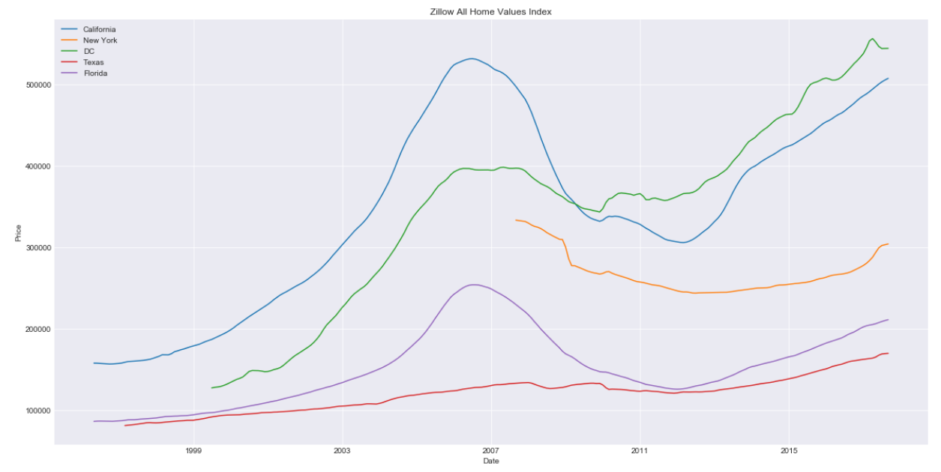
EDA Visualizations

Slide 5
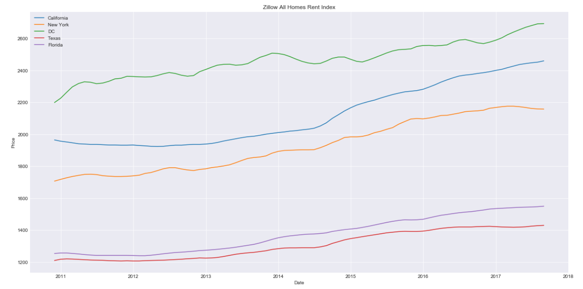
EDA Visualizations

Slide 6
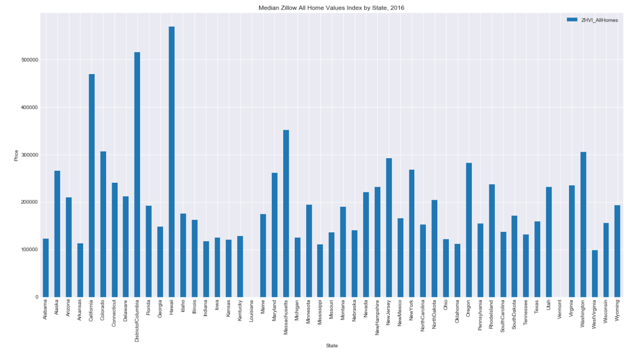
EDA Visualizations

Slide 7
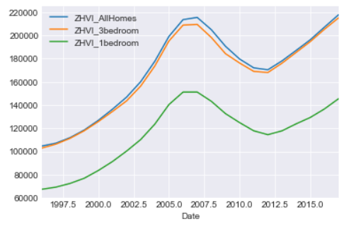
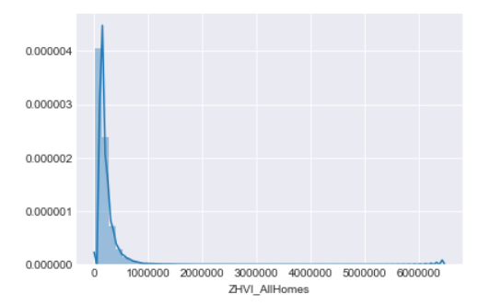
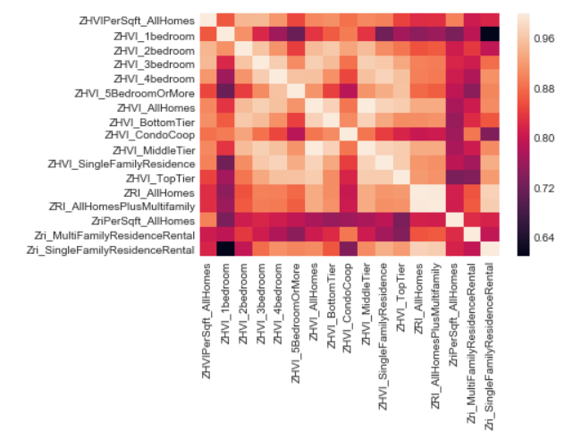

Slide 8
Regression Results
Zillow Home Value Index = B0 + (B1 * Zillow Rent Index) + Error term
Take the first difference
ZHVI % Difference = B0 + (B1 * ZRI % Difference) + Error term

Slide 9
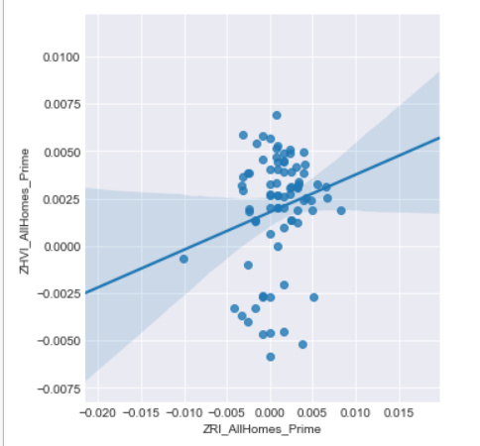

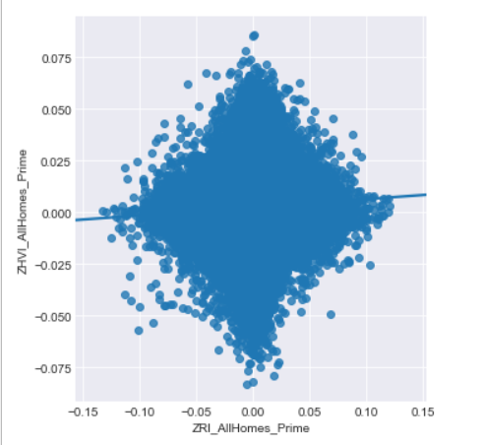

Regression Results
US Median Results (n=81)
US by Geography (n=1,000,000+)

Slide 10
Interpretation
Results are terrible
Difficult to model a national relationship
Catch-22
US median - easier to model, only 82 data points
US Geography – more data points, but no geography constant

Slide 11
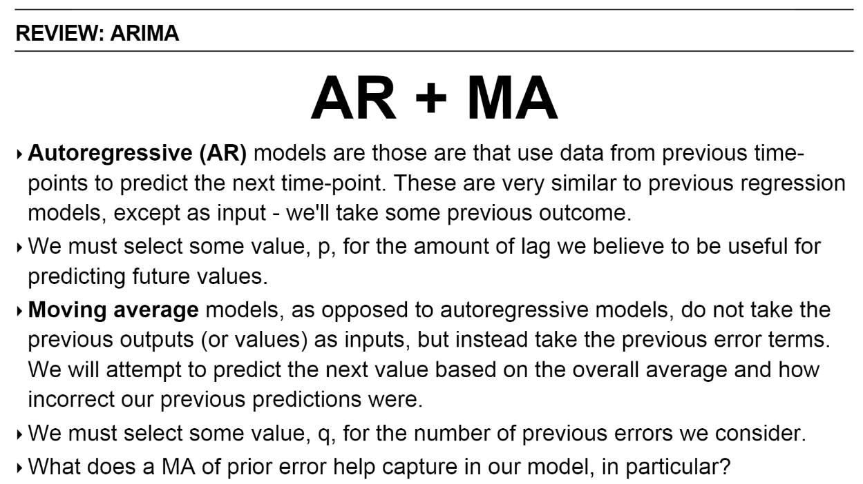
ARIMA Model
Auto-Regressive Integrated Moving Average Model
“Integrated” (d term) means “predicting the difference between one prior period and the new period, rather than predicting the new period’s value itself”
Cite: Joseph Nelson DSI slides

Slide 12
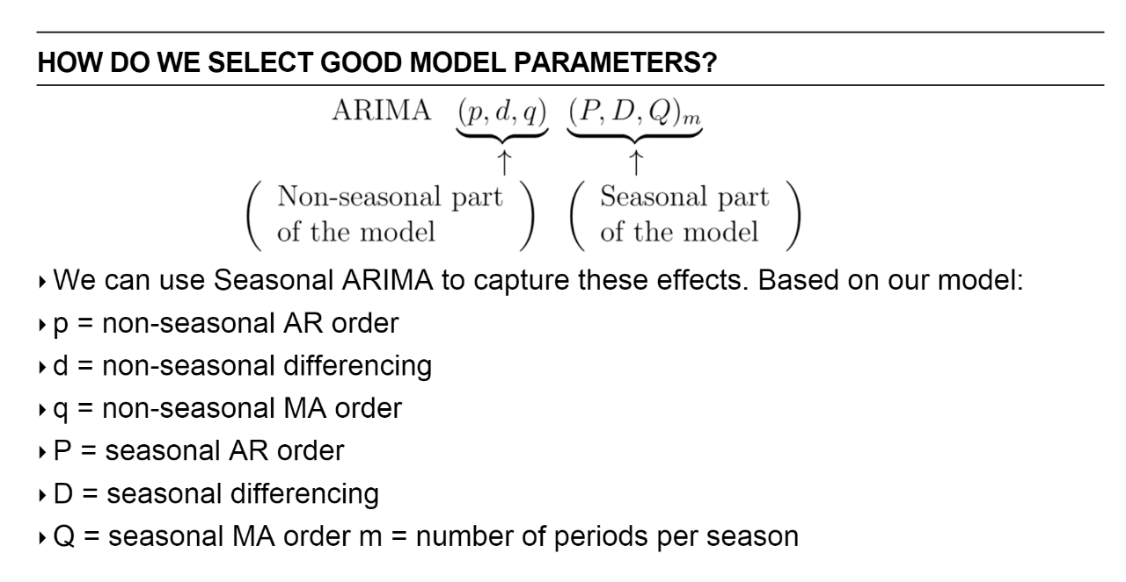
Cite: Joseph Nelson DSI slides

Slide 13
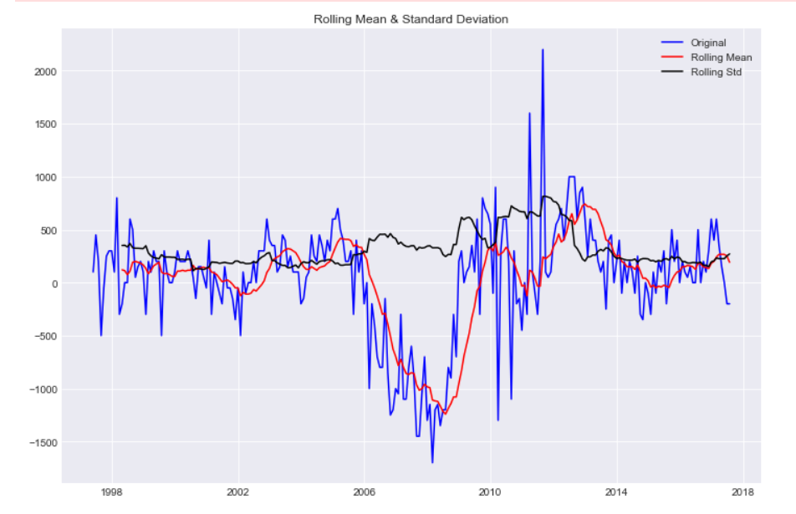
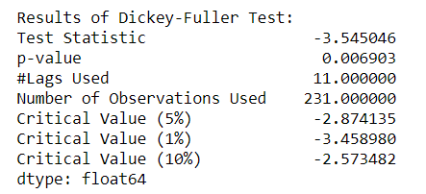
Dickey-Fuller Test (Seasonal First Difference)

Slide 14
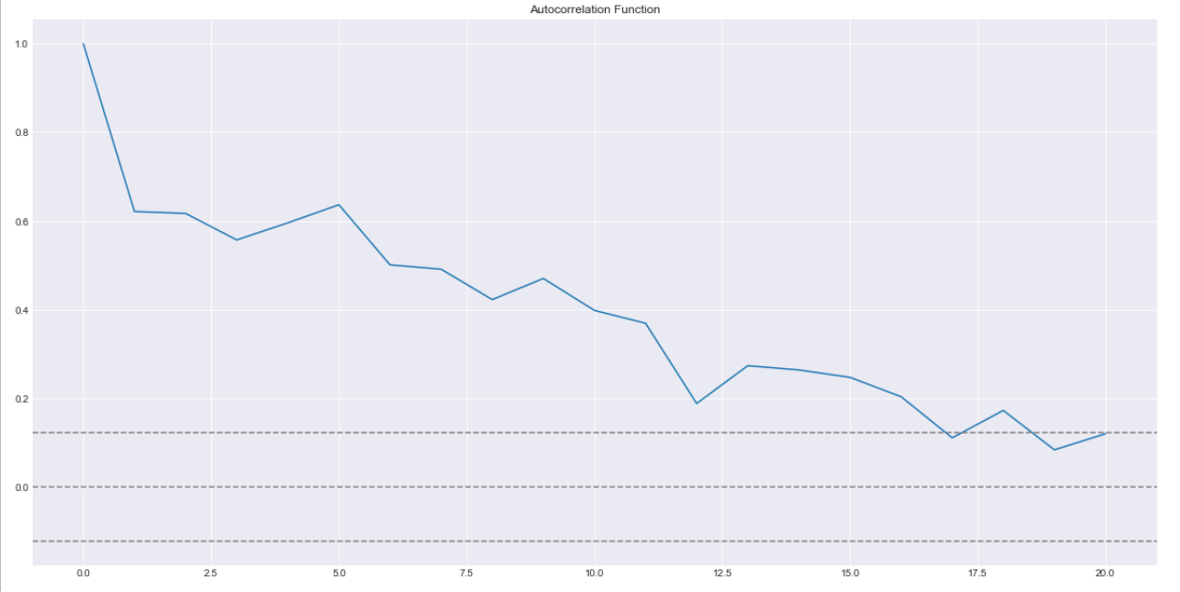
ACF and PACF Tests

Slide 15
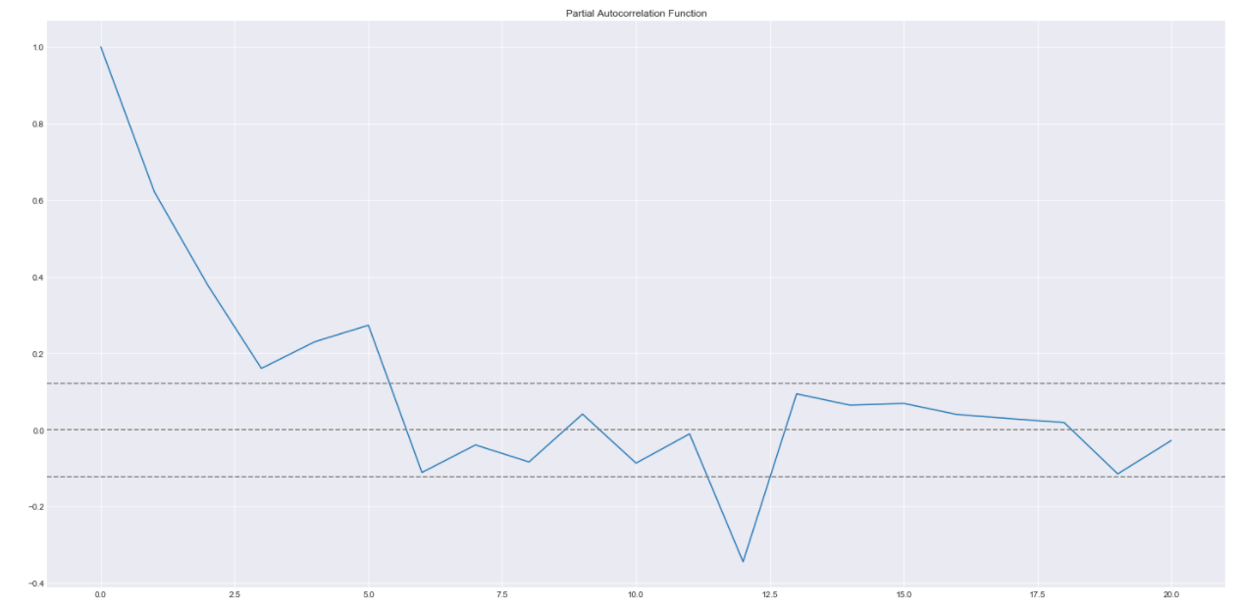
ACF and PACF Tests

Slide 16
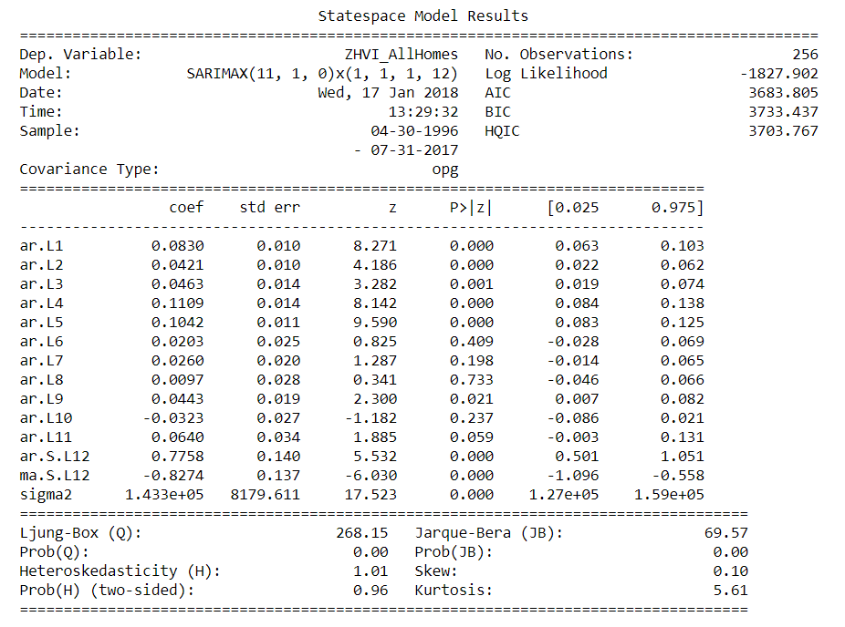
Seasonal ARIMA Results

Slide 17

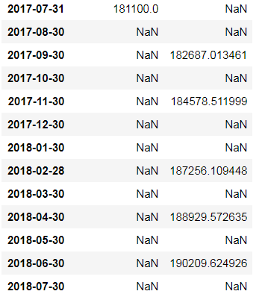
Forecast for 2018
Issue with code
Intermittent predictions

